Slide 1
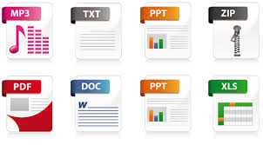

CSC 432
FILE PROCESSING
Lecture 2

Slide 2
Managing Files Of Records: Sequential And Direct Access.

Slide 3
Introduction
A file is a collection of related information defined by its creator. Commonly, files represent programs (both source and object forms) and
data.
File processing refers to an environment in which data are physically organized into files.

Slide 4
Introduction (Cont)
Files are normally organised into directories to ease their use. But when multiple users have access to files, it may be desirable to control whom and in what ways files may be accessed.
File management is a software process concerned with the overall manipulation/ management of files.

Slide 5
Introduction (Cont)
Before data can be processed, it must be systematically organised.
The commonest method is to arrange data into fields, records, files and databases.
Files can be considered to be the framework around which data processing revolves

Slide 6
Elements of a File
A file consists of a number of records. Each record is made up of a number of fields and each field consists of a number of characters.
Logical Components of File deals with the real-world objects the data represent. These are field, record and file.

Slide 7
Elements of a File (Cont)
There are several ways that the information in a file can be accessed. Some systems provide only one access method for files. On the other hand, many different access methods are supported and provided by some other systems.
To choose a method for a particular application is a major design problem. Thus, we will look at the various methods by which files could be organized in memory.
The organization determines the type of access.

Slide 8
File Management
A file is a named entity used to save results from a program or provide data to a program. Access control is enforced generally on file level.
File Management System provides services related to the use of files (e.g. copying, creating, deleting, naming etc.)

Slide 9
Components of File Structure
Field
Basic element of data
Contains a single value
Characterized by its length and data type
Record
Collection of related fields
Treated as a unit
Example: employee record

Slide 10
Components of File Structure (Cont)
File
Collection of similar records
Treated as a single entity
Have unique file names
May restrict access
Database
Collection of related data
Relationships exist among elements

Slide 11
File Organization
File organization is the structure of a file (especially a data file), defined in terms of its components and how they are mapped onto backup storage.
Any given file organization supports one or more file access methods.
Access method is any algorithm used for the storage and retrieval of records from a data file.

Slide 12
File Organization Criteria
In choosing a file organization method, several criteria are important:
Short access time
Ease of update
Economy of storage
Simple maintenance
Reliability.

Slide 13
File Organization Methods
There are five fundamental file organization methods in use. Some algorithms are implemented based on combination two organization methods.
The pile
The sequential file
The indexed sequential file
The indexed file
The direct or hashed file

Slide 14
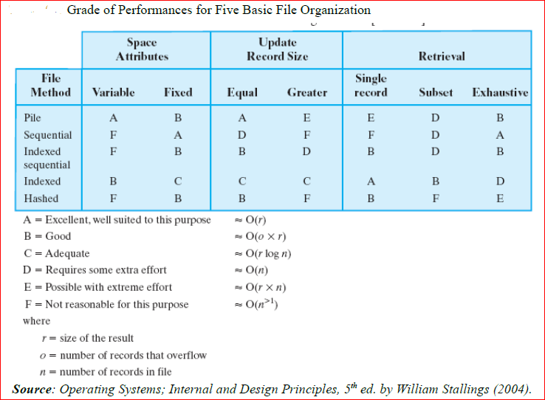

Slide 15
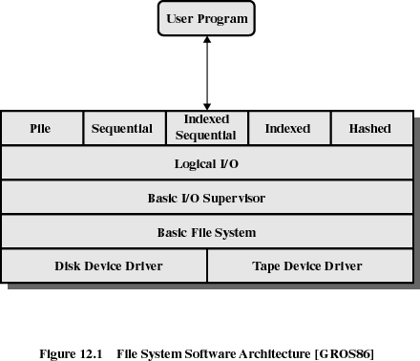

Slide 16
Device Drivers
Lowest level.
Communicates directly with peripheral devices.
Responsible for starting I/O operations on a device.
Processes the completion of an I/O request.

Slide 17
Basic File System
Physical I/O.
Deals with exchanging blocks of data.
Concerned with the placement of blocks.
Concerned with buffering blocks in main memory.

Slide 18
Basic I/O Supervisor
Responsible for file I/O initiation and termination.
Control structures are maintained.
Schedules access to optimize performance.
Part of the operating system.

Slide 19
Logical I/O
Enables users and applications to access records.
Provides general-purpose record I/O capability.
Maintains basic data about file.

Slide 20
File Organization Methods
The Pile or Serial File
Data are collected in the order they arrive.
Purpose is to accumulate a mass of data and save it.
Records may have different fields.
No structure.
Record access is by exhaustive search.

Slide 21
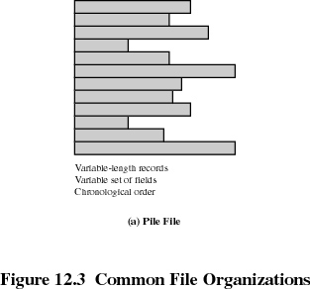
Pile(Cont)

Slide 22
The Sequential File
Fixed format used for records
Records are the same length
All fields are the same (order and length)
Field names and lengths are attributes of the file
One field is the key field
Uniquely identifies the record
Records are stored in key sequence
New records are placed in a log or transaction file
Batch update is performed to merge the log file with the master file

Slide 23
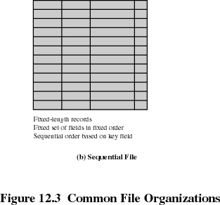
Sequential File(Cont)

Slide 24
Index and Hashing
A number used to select an element of a list, vector, array or other sequence. Such indices are nearly always non-negative integers.
A list of keys (or keywords), each of which identifies a unique record. Indices make it faster to find specific records and to sort records by the index field -- that is, the field used to identify each record.
Hashing is generating a value or values from a string of text or numbers using a mathematical function.

Slide 25
Indexed Sequential File
Index provides a lookup capability to quickly reach the vicinity of the desired record
Contains key field and a pointer to the main file
Index is searched to find highest key value that is equal or less than the desired key value
Search continues in the main file at the location indicated by the pointer

Slide 26
Indexed Sequential File
New records are added to an overflow file
Record in main file (preceding new records in overflow) is updated to contain a pointer to the new record
The overflow is merged with the main file during a batch update
Multiple indexes for the same key field can be set up to increase efficiency

Slide 27
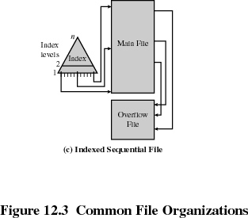
Indexed Sequential File(Cont)

Slide 28
Indexed File
Uses multiple indexes for different key fields
May contain an exhaustive index that contains one entry for every record in the main file
May contain a partial index

Slide 29
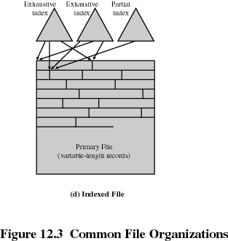
Indexed File(Cont)

Slide 30
The Direct or Hashed File
The direct or hashed file exploits the capability found on disks to access directly any block of a known address.
A key field is also required in each record. However, there is no concept of sequential ordering here. The direct file makes use of hashing on the key value.

Slide 31
The Direct or Hashed File(Cont)
Direct files are often used where;
very rapid access is required
where fixed length records are used
and where records are always accessed one at a time.
Examples are directories, pricing tables, schedules and name lists.

Slide 32
File Directories
Contains information about files
Attributes
Location
Ownership
Directory itself is a file owned by the operating system
Provides mapping between file names and the files themselves

Slide 33
Simple Structure of a Directory
List of entries, one for each file
Sequential file with the name of the file serving as the key
Provides no help in organizing the files
Forces user to be careful not to use the same name for two different files

Slide 34
Two-level Scheme for a Directory
One directory for each user and a master directory
Master directory contains entry for each user
Provides address and access control information
Each user directory is a simple list of files for that user
Still provides no help in structuring collections of files

Slide 35
Hierarchical or Tree-Structured Directory
Master directory with user directories underneath it
Each user directory may have subdirectories and files as entries
Files can be located by following a path from the root or master directory down various branches
This is known as the pathname for the file

Slide 36
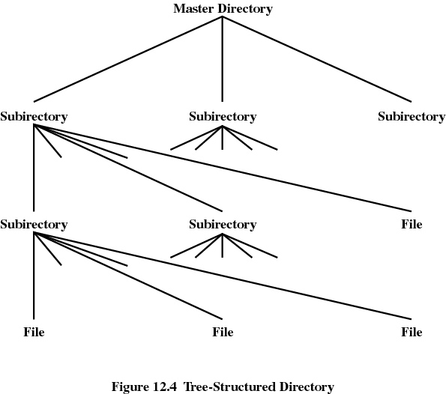
Hierarchical or Tree-Structured Directory(Cont)

Slide 37
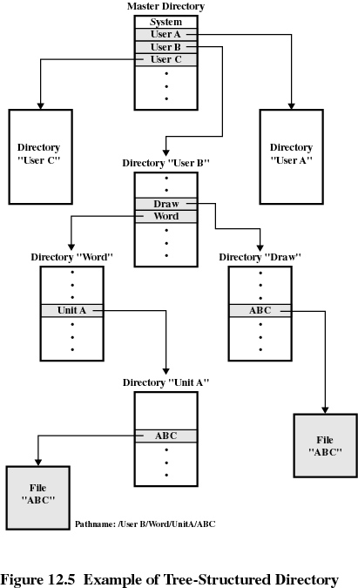
Hierarchical or Tree-Structured Directory(Cont)

Slide 38
Hierarchical or Tree-Structured Directory(Cont)
Can have several files with the same file name as long as they have unique path names
Current directory is the working directory
Files are referenced relative to the working directory

Slide 39
File Sharing
A multiuser system allows files to be shared among users simultaneously.
Two issues
Access rights
Management of simultaneous access

Slide 40
Types of Access Rights
None
User may not know of the existence of the file
User is not allowed to read the user directory that includes the file
Knowledge
User can only determine that the file exists and who its owner is

Slide 41
Types of Access Rights(Cont)
Execution
The user can load and execute a program but cannot copy it
Reading
The user can read the file for any purpose including copying and execution
Appending
The user can add data to the file but cannot modify or delete any of the file’s contents

Slide 42
Types of Access Rights(Cont)
Updating
The user can modify, delete and add to the file’s data. This includes creating the file, rewriting it, and removing all or part of the data
Changing protection
User can change access rights granted to other users (mostly Admin)
Deletion
User can delete the file

Slide 43
Types of Access Rights(Cont)
Owners
Has all rights previously listed
May grant rights to others using the following classes of users
Specific user
User groups
All for public files

Slide 44
Simultaneous Access
User may lock entire file when it is to be updated
User may lock the individual records during the update
Mutual exclusion and deadlock are issues for shared access

Slide 45
Record Blocking Methods
Record blocking techniques are used to reduce the computational complexity associated with record linkage. It is a preprocessing step for record linkage.
Record linkage seeks to merge databases and to remove duplicates when unique identifiers are not available. This process matches records across data sets that refer to the same entity.

Slide 46
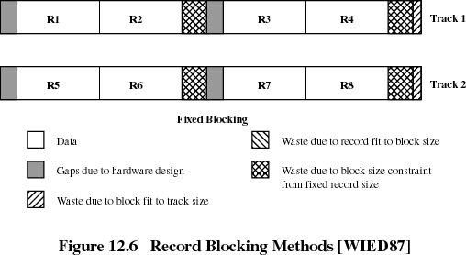
Fixed Blocking

Slide 47
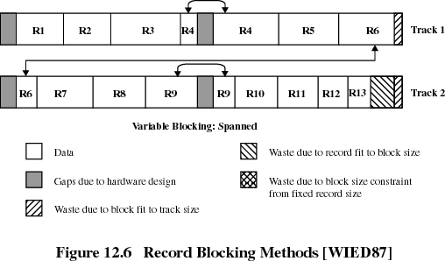
Variable Blocking: Spanned

Slide 48
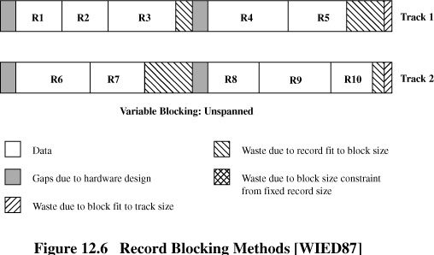
Variable Blocking Unspanned

Slide 49
Secondary Storage Management
Space must be allocated to files
Must keep track of the available space for allocation

Slide 50
Preallocation
Need the maximum size for the file at the time of creation
Difficult to reliably estimate the maximum potential size of the file
Tend to overestimated file size so as not to run out of space

Slide 51
Methods of File Allocation
Contiguous allocation
Single set of block is allocated to a file at the time of creation
Only a single entry in the file allocation table
Starting block and length of the file
External fragmentation will occur

Slide 52
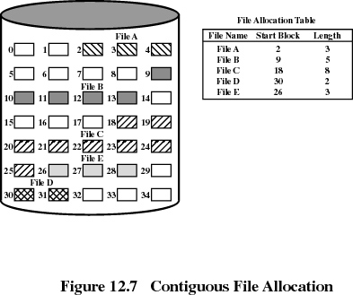
Contiguous allocation(Cont)

Slide 53
Methods of File Allocation(Cont)
Chained allocation
Allocation is based on individual block
Each block contains a pointer to the next block in the chain
Only single entry in the file allocation table
Starting block and length of file
No external fragmentation
Best for sequential files
No accommodation of the principle of locality

Slide 54
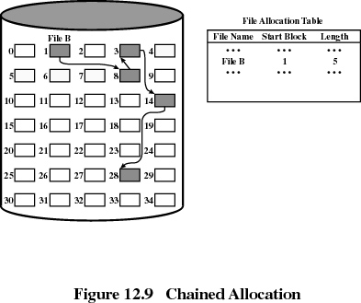
Chained Allocation(Cont)

Slide 55
Methods of File Allocation(Cont)
Indexed allocation
File allocation table contains a separate one-level index for each file
The index has one entry for each portion allocated to the file
The file allocation table contains block number for the index

Slide 56
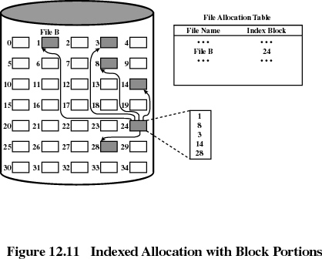
Indexed allocation(Cont)

Slide 57
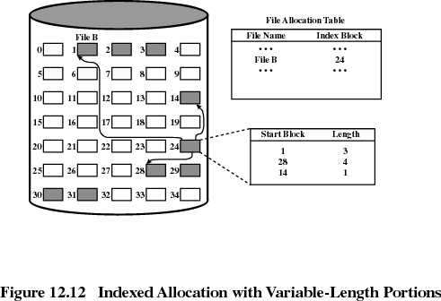
Indexed allocation(Cont)

Slide 58
UNIX File Management
Types of files
Ordinary
Directory
Special
Named

Slide 59
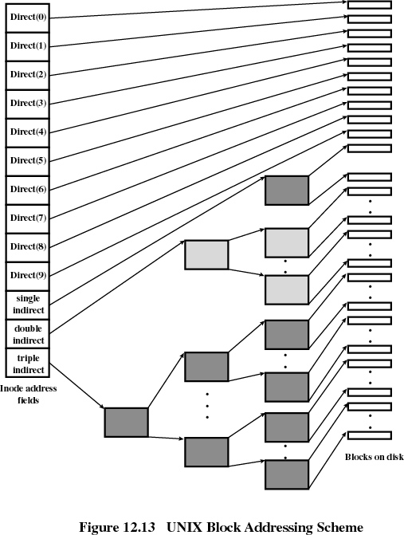
UNIX File Management(Cont)

